Slide 1
ECEN 204 Electronic Design
Section 4c FET Amplifiers

Slide 2
CS Amplifier
The Common-Source Amplifier
In a CS amplifier, the input signal is applied to the gate and the output signal is taken from the drain. The amplifier has higher input resistance and lower gain than the equivalent CE amplifier.
The voltage gain is given by the equation A_{v} = g_{m}R_{d}.
FET AC model is not included in this course (ECEN403)

Slide 3
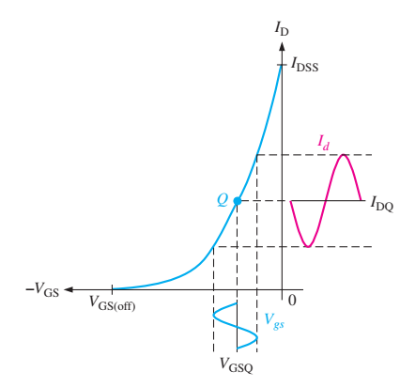





Slide 4
Admittance
The Common-Source Amplifier
Recall that conductance is the reciprocal of resistance and admittance is the reciprocal of impedance. Data sheets typically specify the forward transfer admittance, y_{fs} rather than transconductance, g_{m}. The definition of y_{fs} is
An alternate gain expression for a CS amplifier is A_{v} = y_{fs}R_{d}.

Slide 5
Transfer Characteristic
The Common-Source Amplifier
You can estimate what the transfer characteristic looks like from values on the specification sheet, but keep in mind that large variations are common with JFETs. For example, the range of specified values for a 2N5458 is shown.

Slide 6
Electronic Devices
The Common-Source Amplifier
To analyze the CS amplifier. you need to start with dc values. It is useful to estimate I_{D} based on typical values; specific circuits will vary from this estimate.
Example:
For a typical 2N5458, what is the drain current?
2N5458
From the datasheet, the typical I_{DSS} = 6.0 mA and V_{GS(off)} = −4 V. These values can be plotted along with the load line to obtain a graphical solution. as shown in the next slide.

Slide 7

Electronic Devices
The Common-Source Amplifier
Solution:
(continued)
A graphical solution is illustrated. On the transconductance curve, plot the load line for the source resistor.
Load line for 470 Ω resistor

Slide 8
Electronic Devices
The Common-Source Amplifier
Solution:
(continued)
A graphical solution is illustrated. On the transconductance curve, plot the load line for the source resistor.
Load line for 470 Ω resistor
Then read the current and voltage at the Q-point.
Q

Slide 9
Electronic Devices
The Common-Source Amplifier
Solution:
(continued)
A graphical solution is illustrated. On the transconductance curve, plot the load line for the source resistor.
Load line for 470 Ω resistor
Then read the current and voltage at the Q-point.
Q
2.8 mA
I_{D} = 2.8 mA and V_{GS} = −1.3 V
−1.3 V

Slide 10
Electronic Devices
The Common-Source Amplifier
Solution:
(continued)
Alternatively, you can obtain I_{D} using Equation:
The solution to this quadratic equation is simplified using a calculator that can handle quadratic equations.

Slide 11
Electronic Devices
The Common-Source Amplifier
Example:
Assume I_{DSS} is 6.0 mA, V_{GS(off)} is −4 V, and V_{GS} = −1.3 V as found previously. What is the expected gain?
Output is inverted
2N5458
A_{v} = g_{m}R_{d} = (2.02 mS)(2.7 kΩ) = 5.45

Slide 12
Electronic Devices
The Common-Source Amplifier
The gain is reduced when a load is connected to the amplifier because the total ac drain resistance (R_{d}) is reduced.
Example:
How does the addition of the 10 kΩ load affect the gain?
2N5458

Slide 13
Electronic Devices
The Common-Source Amplifier
The gain is reduced when a load is connected to the amplifier because the total ac drain resistance (R_{d}) is reduced.
Example:
How does the addition of the 10 kΩ load affect the gain?
Solution:
2N5458
A_{v} = g_{m}R_{d} = (2.02 mS)(2.13 kΩ) = 4.29

Slide 14
D-MOSFET
The D-MOSFET
In operation, the D-MOSFET has the unique property in that it can be operated with zero bias, allowing the signal to swing above and below ground. This means that it can operate in either D-mode or E-mode.

Slide 15
E-MOSFET
The E-MOSFET
The E-MOSFET is a normally off device. The n-channel device is biased on by making the gate positive with respect to the source. A voltage-divider biased E-MOSFET amplifier is shown.

Slide 16
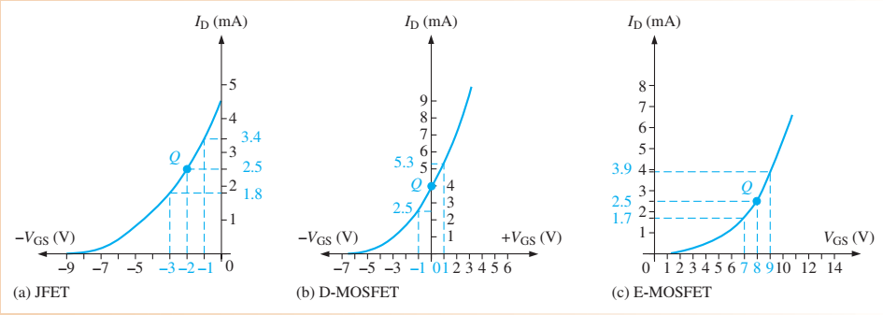
All Three

Slide 17

CD Amplifier
The Common-Drain Amplifier
In a CD amplifier, the input signal is applied to the gate and the output signal is taken from the source. There is no drain resistor, because it is common to the input and output signals.
The voltage gain is given by the equation
The voltage gain is always < 1, but the power gain is not.
Since output is from Source, it is in phase with gate voltage.

Slide 18
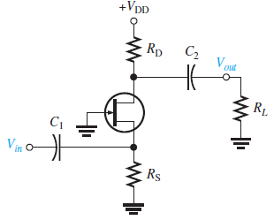

CG Amplifier
The Common-Gate Amplifier
For the common-gate amplifier , the input is applied to the source and the output is taken from the drain. As in the case of the common-source amplifier, the voltage gain equation is:
A_{v} = g_{m}R_{d}
The current gain is very close to 1. The CG amplifier has low input resistance and high output resistance, so is a good current buffer. This means it can transform the effective resistance of a current source into one with higher resistance.
Applications include high-frequency receivers and applications where matching the source impedance is important. Notice that the output signal is in phase with the input, an advantage at high-frequencies.

Slide 19
Electronic Devices
Selected Key Terms-1
Common-source
Common-drain
Source-follower
Common-gate
A FET amplifier configuration in which the source is the (ac) grounded terminal.
A FET amplifier configuration in which the drain is the (ac) grounded terminal.
The common-drain amplifier.
A FET amplifier configuration in which the gate is the (ac) grounded terminal.

Slide 20
Electronic Devices
Quiz Q1
1. Compared to a common-emitter amplifier, a common-source amplifier generally will have
a. higher gain and higher input resistance
b. higher gain and lower input resistance
c. lower gain and higher input resistance
d. lower gain and lower input resistance

Slide 21
Electronic Devices
Quiz Q2
2. The abbreviation y_{fs} means
a. forward transfer admittance
b. forward on-state resistance
c. reverse transfer susceptance
d. reverse on-state conductance

Slide 22
Electronic Devices
Quiz Q3
3. The plot shown is a graphical solution for a self-biased FET amplifier. The red line represents the
a. gate resistor
b. source resistor
c. drain resistor
d. none of the above

Slide 23
Electronic Devices
Quiz Q4
4. The resistance represented by the red line is
a. 150 Ω
b. 240 Ω
c. 470 Ω
d. 666 Ω

Slide 24
Electronic Devices
Quiz Q5
5. The gain equation is used to calculate the gain of
a. a CS amplifier
b. a CD amplifier
c. a CG amplifier
d. any of the above

Slide 25
Electronic Devices
Quiz Q6
6. A FET that can be biased with zero bias is a
a. an n-channel JFET
b. a D-MOSFET
c. an E-MOSFET
d. all of the above

Slide 26
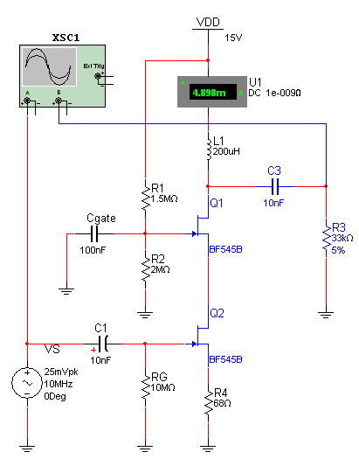
Electronic Devices
Quiz Q7
7. The cascode amplifier shown uses
a. A CS and a CD stage
b. Two CS stages
c. Two CD stages
d. none of the above

Slide 27
Electronic Devices
Quiz Q8
8. The principle circuit used in creating a pulse width modulator is a
a. peak detector
b. clipper
c. comparator
d. low-pass filter

Slide 28
Electronic Devices
Quiz Q9
9. The circuit is an amplifier for a pulse width modulated signal. The load has the demodulated signal. The yellow box represents a
a. peak detector
b. clipper
c. comparator
d. low-pass filter

Slide 29
Electronic Devices
Quiz Q10
10. When the control signal is active, the output of an analog switch should look like
a. the input signal
b. a square wave
c. a modulated pulse
d. a dc level

Slide 30
Electronic Devices
Answers
Answers:
1. c
2. a
3. b
4. d
5. b
6. b

